Slide 1
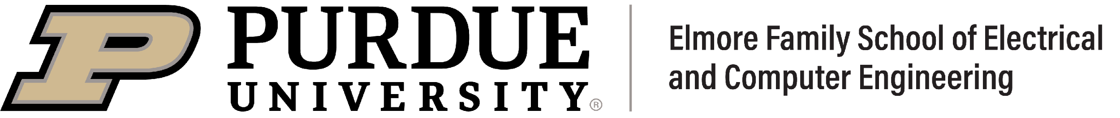


Interoperability in Deep Learning: A User Survey and Failure Analysis of ONNX Model Converters
Purvish Jajal, Wenxin Jiang, Arav Tewari, Erik Kocinare, Joseph Woo, Anusha Sarraf, Yung-Hsiang Lu, George K. Thiruvathukal, James C. Davis
Notes:
Hello, my name is …
And I am going to be presenting our work Interope

Slide 2
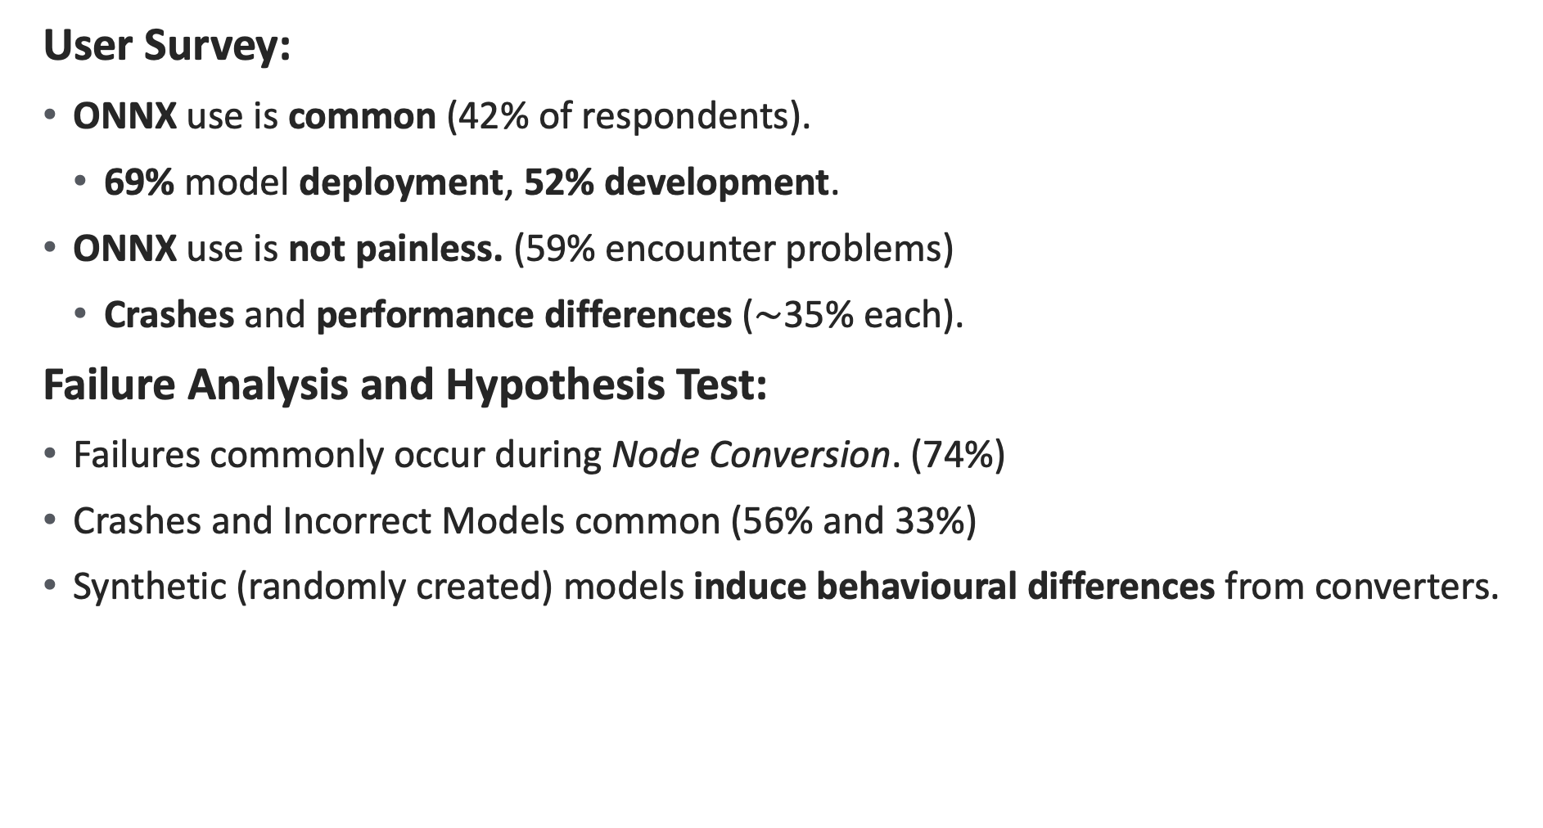
Summary
User Survey:
ONNX use is common (42% of respondents).
69% model deployment, 52% development.
ONNX use is not painless. (59% encounter problems)
Crashes and performance differences ($\sim$35% each).
Failure Analysis and Hypothesis Test:
Failures commonly occur during Node Conversion. (74%)
Crashes and Incorrect Models common (56% and 33%)
Synthetic (randomly created) models induce behavioural differences from converters.
Notes:
In this paper we study interoperability in the context of deep learning software, specifically ONNX.
There is a variety of DL software:
frameworks to build and train models,
compilers and runtimes to deploy them (run them in an optimized way)
ONNX is a format for DL models, that allows models to be used across this software.
We do three things in this work: User Survey, Failure Analysis, and Hypothesis Test
What do we find?
From our user survey
We find that ONNX use is common (42% of respondents use it).
The main use cases are deployment (using ONNX to run a model) and model development (using ONNX to convert a model to your framework).
ONNX is not painless to use. 59% of respondents encounter problems.
The major reported problems are crashes and performance differences.
From our failure analysis
Failures commonly occur during a single stage, the Node Conversion stage.
Conversions failing or being incorrect is common
A great way to cause converters to fail is just by generating random models
I will now provide a bit of background go further in depth

Slide 3
Background

Slide 4
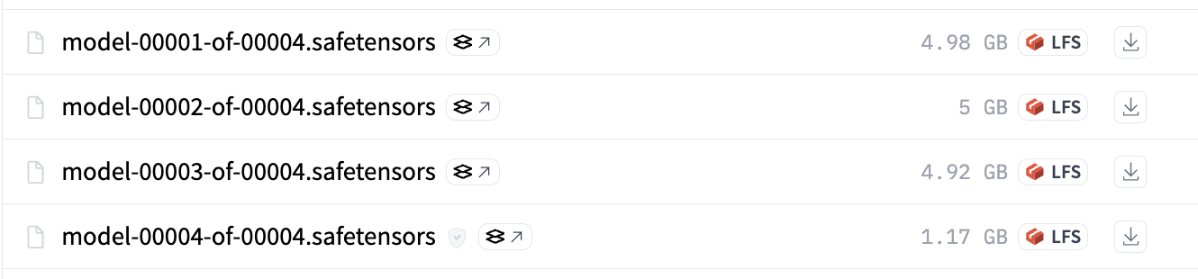
Deep Learning (DL) Models
Architecture
Weights
Linear
ReLU
Linear
Notes:
What are deep learning models -> neural networks
There are lots of examples: transformer, convolutional neural networks, recurrent neural networks.
A deep learning model is really two things:
1. An “architecture” i.e., a series of mathematical operations (in some order)
2. Weights, which are the parameters used in these mathematical operations
Training scripts are not included, we only care about architecture + weights.
So how do people create and use these models?

Slide 5

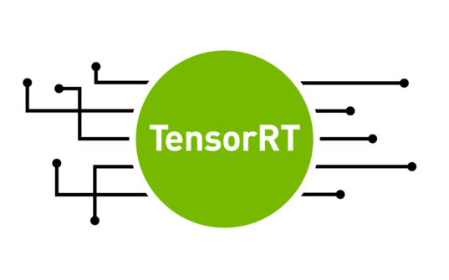
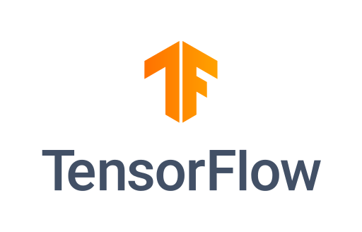

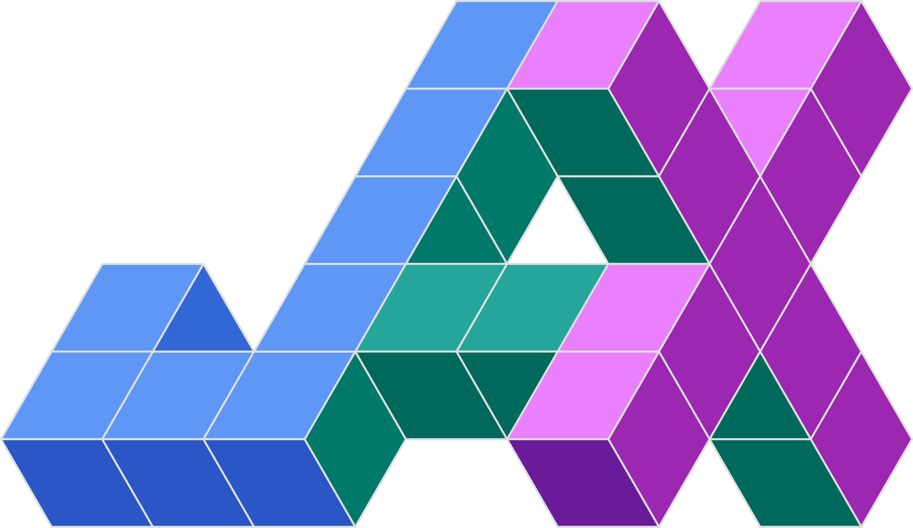
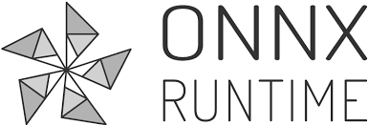

Deep Learning Software
DL Frameworks
DL Compilers/Runtimes
Notes:
Deep Learning Software -> used to design, train, and deploy models, it is diverse and it is growing
DL Frameworks: design and train models, e.g., PyTorch, TensorFlow, JAX, MLX (if you have Apple Silicon)
DL Compilers: deployment, e.g., TensorRT, TVM, ONNXRuntime

Slide 6
Pairwise Mapping Problem and Interoperability
DL Frameworks
DL Compilers/Runtimes
Notes:
DL Frameworks: design and train models, e.g., PyTorch, TensorFlow, JAX, MLX (if you have Apple Silicon)
DL Compilers: deployment (you want to run a model in an optimized fashion), e.g., TensorRT, TVM, ONNXRuntime
all this software of typically has their own format for models
PyTorch does not represent a model in the same way as TensorFlow
This is important because these model should be able to be exchanged
For TensorRT and TVM to support PyTorch models they need to be able to convert the PyTorch format to TensorRT and TVM format.
And similarly for all the other pieces of software.
This creates a pairwise mapping between software.
This pairwise mapping is hard to scale as ecosystem grows

Slide 7





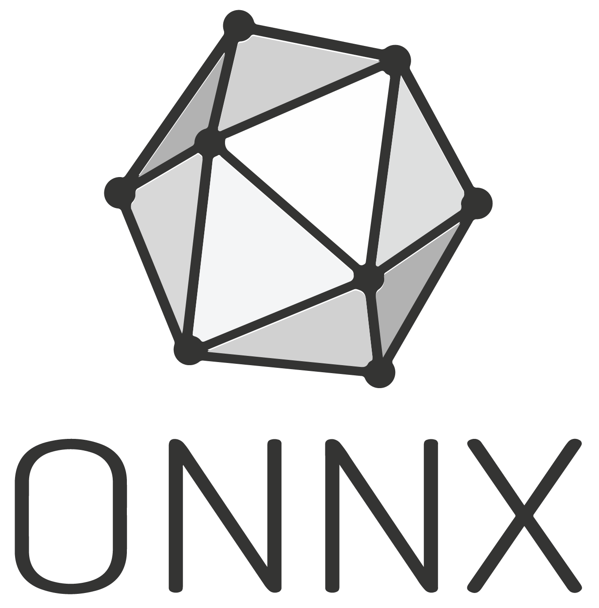
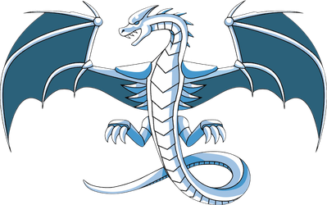



ONNX IR as a Common Intermediary
Deep Learning Software
Traditional Software
LLVM IR
Notes:
As a solution common intermediaries such as ONNX act as a common format that is understood by different DL software
Models from different frameworks just need to be converted to ONNX and compilers only need to learn to read ONNX.
This is analogous to LLVM IR. You can have front-ends that compile your program to the LLVM IR.
This IR can then be optimized and used to create binaries for a target machine.

Slide 8
ONNX as a Common Intermediary
LLVM IR
Notes:
As a solution to the complexity in the DL ecosystem, common intermediaries such as ONNX act as a common format that is understood by different DL software
Models from different software are converted to and from ONNX format.
This is analogous to LLVM IR. You can have front-ends that compile your program to the LLVM IR.
This IR can then be optimized and used to create binaries for a target machine.

Slide 9
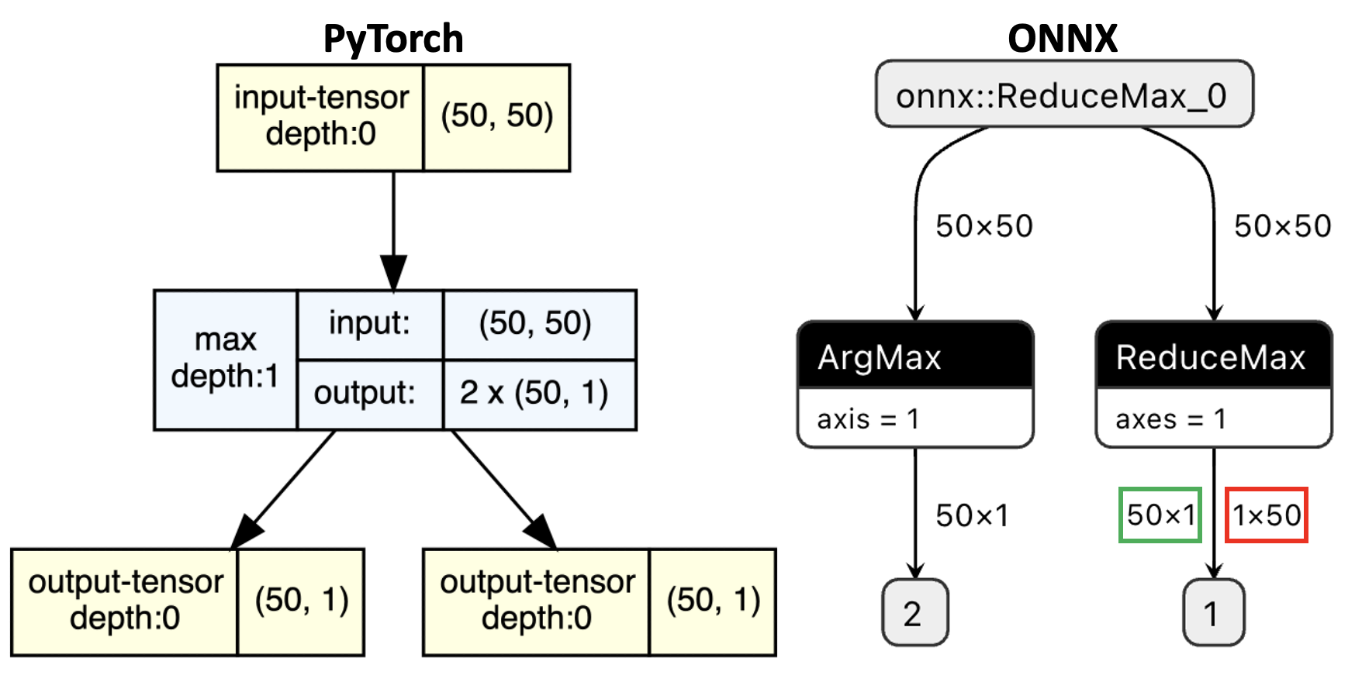
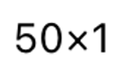
ONNX Representation and Converters
Model Converter
Notes:
So, what is ONNX?
ONNX is a specification for DL models. It specifies how to represent models using a finite set of operators in the ONNX Opset.
A model is converted from one format to another using a model converter.
Here is an example of this:
A model in PyTorch can be represented as an equivalent (hopefully) ONNX model.
In this example, we have a simple PyTorch model that applies the `max` operation on an input, this returns two outputs.
The ONNX equivalent is on the right.
The ONNX applies two operations on the input ArgMax and ReduceMax, this is equivalent to PyTorch.

Slide 10
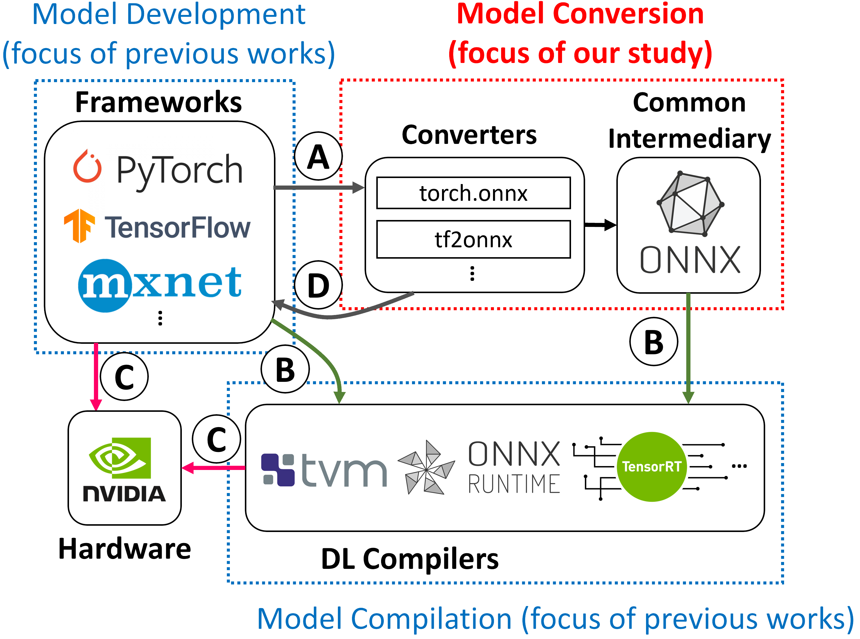
Model Converters Play a Key Role in the DL Ecosystem
Notes:
How do converters fit in? You can see that converters can act as intermediaries between frameworks and compilers.
The DL ecosystem is complex.
Framework are used for model development.
Compilers which are used for deployment.
And converters and common intermediaries are used to allow these various pieces of software to interoperate with each other.
They play a key role in the ecosystem and can affect deployment and development!
A represents model conversion to a common intermediary.
B represents compilation.
C represents model deployment. (From FW or Compiler)
D represents model conversion to a framework.

Slide 11
Study Structure

Slide 12
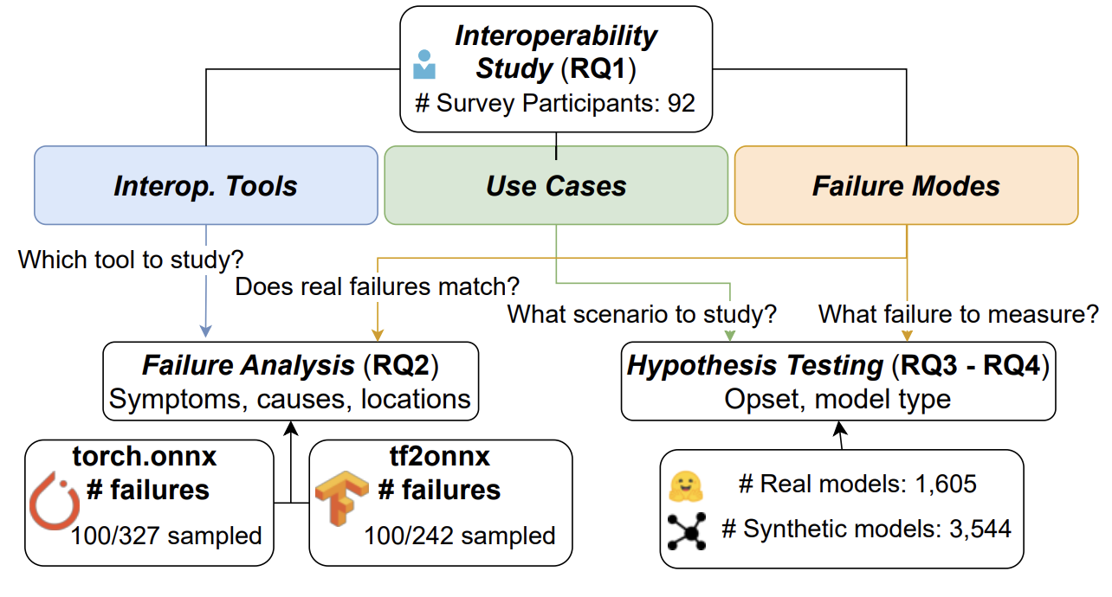
Study Structure
Notes:
We want to know about deep learning interoperability.
Specifically: Tools, Use Cases, Failure Modes, where do engineers need help. We conduct a survey to answer this.
We use the results from our survey to guide and motivate a failure analysis and hypothesis test.
Today, I will only mainly present results from the Interop. Study, Failure Analysis. For all the results I refer you to the paper.

Slide 13
Study Part 1: Interoperability Study
RQ1: How and why do engineers use interoperability tools?

Slide 14
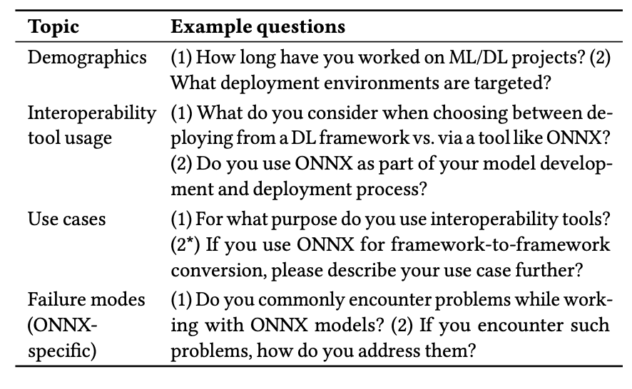
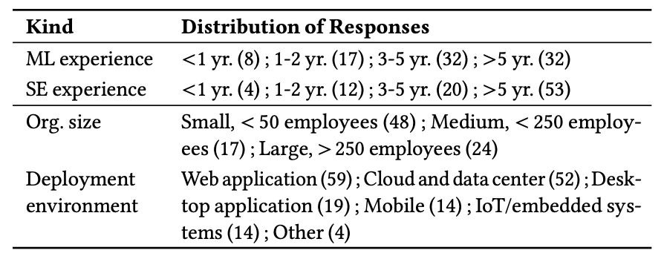
Survey Methodology
HuggingFace Users → Surveyed 228 PRO users and 1,985 organization members.
92 valid responses (4% response rate).
Notes:
In this work we conduct a survey of HuggingFace users to understand how engineers use interoperability tools.
We received 92 valid responses with a 4% response rate.
A large portion of respondents had more than 3 years of experience as SWEs or MLEs.
Our respondents typically work on Web Applications or Cloud and Data Center
We ask questions related to their use of interop tools: why choose onnx? How do they use it?
We ask about their use cases? Which type of conversion do they typically do?
We ask about what failure modes they encounter

Slide 15
Survey Methodology
HuggingFace Users → we contacted 228 PRO users and 1,985 organization members.
92 valid responses (4% response rate).
Question Topics: demographics, interoperability tool usage, use cases, failure modes.
Notes:
Population of study: HuggingFace users
Contact 228 Pro users and 1,985 organization members
92 valid responses with a 4% response rate.
A large portion of respondents had more than 3 years of experience as SWEs or MLEs.
Our respondents typically work on Web Applications or Cloud and Data Center
We have a good spread of organization sizes.
We ask questions related to their use of interop tools: why choose onnx? How do they use it?
We ask about their use cases? Which type of conversion do they typically do?
We ask about what failure modes they encounter

Slide 16
Converter Use is Common and a Pain Point
42% use ONNX.
41% don’t use any interoperability tool.
Common Use Cases:
(A → B → C) – 69% (37/54)
(A → D) – 52% (28/54)
“exports [pre-trained models] to ONNX for import into Axon, an Elixir/Nx based DL framework that often [lacks] native pre-trained models”
Users report models don’t convert or have behavioural differences (35% each).
A
D
B
C
Notes:
We find of the respondents, 42% (39/92) report using ONNX.
41% do not use any interoperability tool.
We also asked users how they used these tools.
69% of respondents report using interoperability tools for deployment! (A --> B → C).
52% use interoperability tools to convert between frameworks (A → D).
One respondent reports using ONNX to convert pre-trained models into another DL framework which lacks native PTMs.
Users report that interoperability tools have pain points:
Don’t convert
Behavioural differences between original models and converted

Slide 17
Study Part 2: Failure Analysis
RQ2: What are the failure characteristics in DL interoperability software — symptoms, causes, and locations?

Slide 18
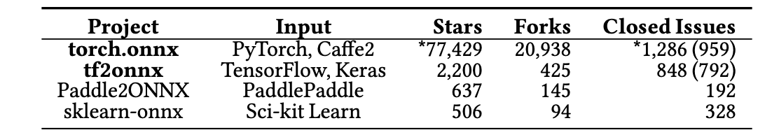
Failure Analysis: Methodology
We collect and study issues from the PyTorch and TensorFlow model converters (torch.onnx and tf2onnx).
Analyze 200 issues for symptoms, causes, and location of failures.
Notes:
We conduct a failure analysis to understand what the symptoms, causes, and locations of failures are.
We collect 200 issues from the tf2onnx and pytorch repositories, as these are the largest converters with the most available data.
our survey found PyTorch and TensorFlow are the most used frameworks.

Slide 19
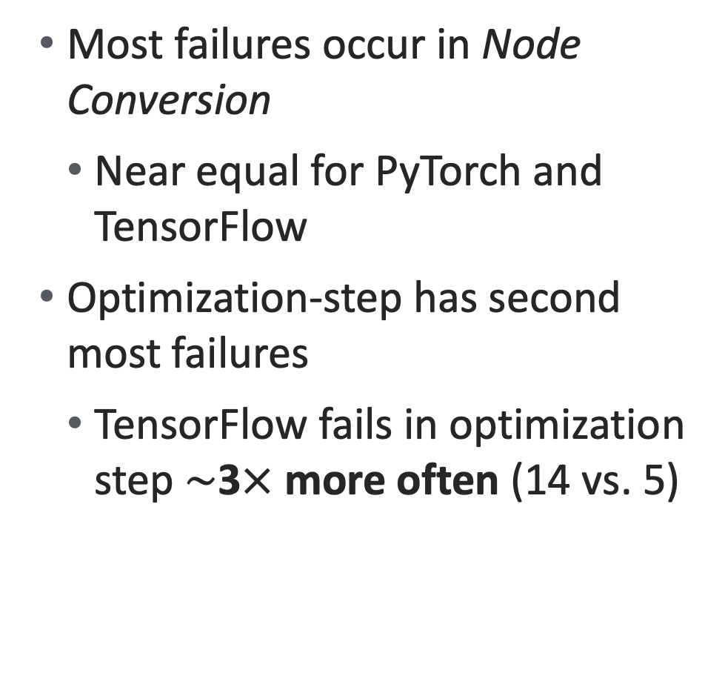
Failure Analysis: Locations
TensorFlow/PyTorch Model
Most failures occur in Node Conversion
Near equal for PyTorch and TensorFlow
Optimization-step has second most failures
TensorFlow fails in optimization step $\sim$3$×$ more often (14 vs. 5)
11 (6%)
Load Model
148 (74%)
Node Conversion
19 (10%)
Optimization
1 (1%)
Export
3 (2%)
Validation
ONNX Model
Notes:
So where in the conversion process do failures typically occur?
On the right you can see the typical conversion process from PyTorch/TensorFlow to an ONNX model.
Failures typically occur in the Node Conversion (74%) and Optimization (10%) steps. We note that the tensorflow converter actually failed more often than the PyTorch at the optimization step.
What do these failures look like
Node conversion: Graph nodes replaced by ONNX equivalents.
This type of failure can occur in state-of-the-art models where new operations may not be entirely supported by ONNX and conversion fails.
Or when the converters incorrectly convert a node.
Optimization: Nodes (e.g., operator fusion), dataflows (e.g., DCE). As is common with IRs you can optimize them, the optimization step typically involves looking at the converted model and rewriting parts of it in a more optimal way.
The optimization results in a model that is not equivalent (even though it previously was).
Load Model: Framework representation → ONNX graph. Tracing used for dynamic graphs (e.g., PyTorch).
Export Model: serialized into protocol buffer (protobuf).
Validate: Syntactic checks (compliance with spec) and semantic checks (behavioral changes).

Slide 20
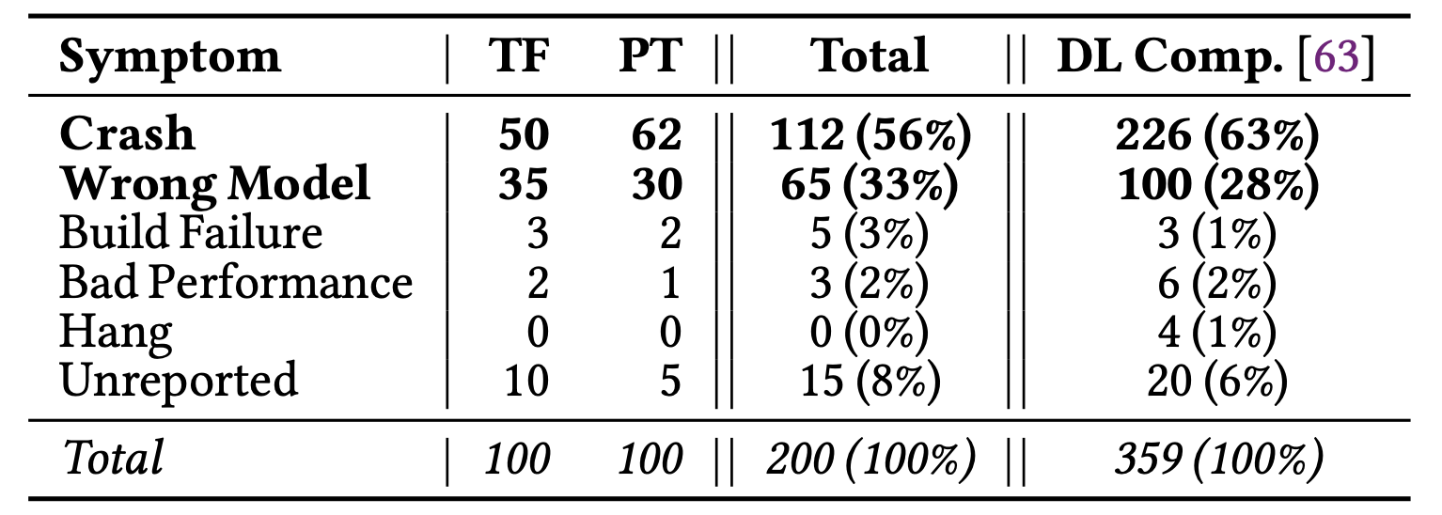
Failure Analysis: Common Symptoms
Crash (56%) and Wrong Model (33%) are most common symptoms.
Conversions fail (typically gracefully)
Converted models don’t match original
In line with earlier survey results.
Error throw (gracefully)
Syntactically Correct,
Semantically Incorrect
Notes:
We analyze failure symptoms.
There are two symptoms that are most common:
Crashes: The converter errors out (typically gracefully). This one is not necessarily bad, but this does affect the experience of users. Often engineers are unable to convert certain models due to the operations within their model not being supported. This can hinder the efficacy of ONNX as an interoperability tool.
Wrong Model: The converter produces a syntactically correct yet semantically incorrect model. This is very bad, and the second most common. Engineers can convert a model, but the converted model is not equivalent to the original. Sometimes, even though there is a ”proper conversion” i.e., the nodes are converted correctly, the model may not behave the same and may exhibit differences in output..

Slide 21
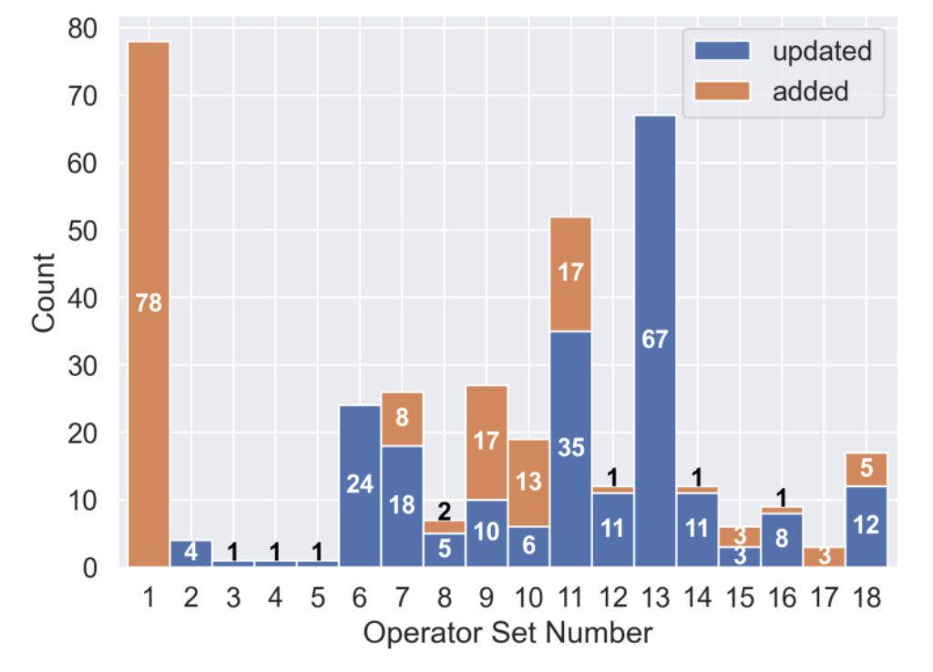
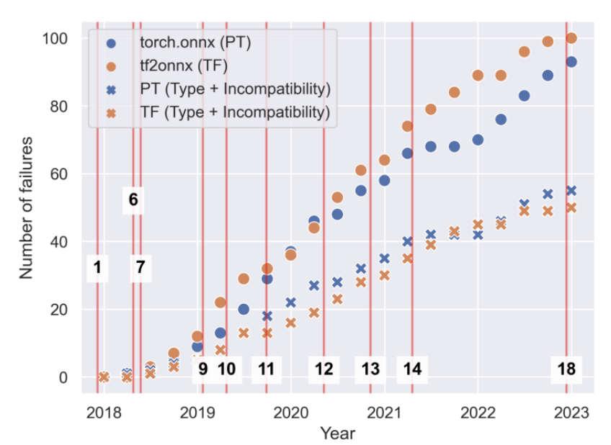
Failure Analysis: Effect of ONNX changes
Notes:
To try to understand how fragile ONNX converters are to changes in the ONNX specification we measure how the number of failures change with each opset release.
On the left you can see the number of operators added/changed in a release. If converters were fragile we would measure failure spikes following a release. On the right you see the cumulative number of failures as measured since the release of ONNX.
We don’t really see any drastic increases.
Quantitatively, we don’t really measure any strong correlations between opset releases and measured failures. We measure a Spearman correlation of 0.34 (a weak positive correlation).
Something that can explain this is the fact that converters typically support multiple opsets, and as such if there is a breaking change typically engineers can convert using an older opset. This is actually one of the solutions users report in our User Study. When they cannot convert they typically attempt to change the opset version.

Slide 22
Study Part 3: Deeper Causes
RQ3:Does ONNX evolution affect converter failure rates?
RQ4: Do model types affect converter failure rates?
Notes:
The third part of our study focuses upon so-called “deeper cause”.

Slide 23

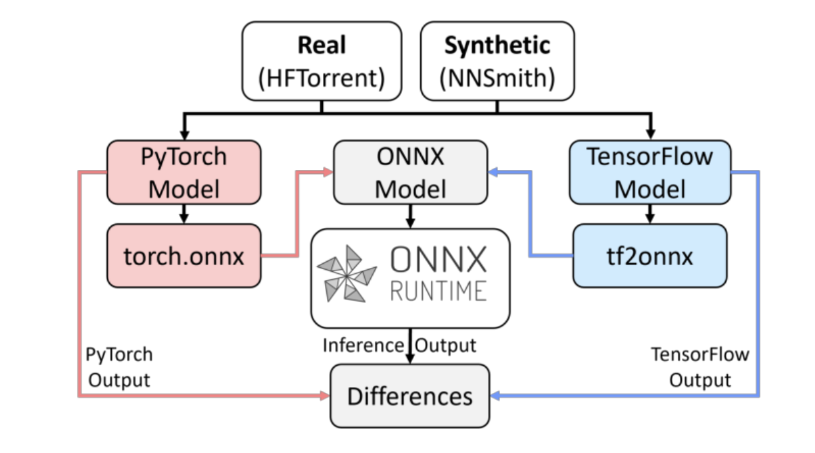

Model Types and Failures: Methodology
H_{RQ3} : Changes in ONNX operator sets are correlated with increased defects
H_{RQ4} : Failures are caused by model structure, i.e., models with particular layers (node) or layer sequences are more prone to defects
Notes:
To answer our two prior research questions, we conduct a hypothesis test.
For RQ3: We hypothesize that failures are related with changes in the ONNX operator set, correlated with increased defects.
For RQ4: we hypothesize that failures are caused by model structure, maybe individual layers (nodes) or layer sequences are more prone to defects.
For RQ4: we conduct a differential test using two classes of models and analyze failing models. For brevity I won’t cover this today.
We do not find evidence to support our first hypothesis and reject it.
We do find evidence to support our second hypothesis, there are classes of models that cause converter failure disproportionately, namely unnatural or synthetic models.
We do not find individual layers that cause failure, but we do find unique layer sequences shared between failing models that are not in correct ones.

Slide 24
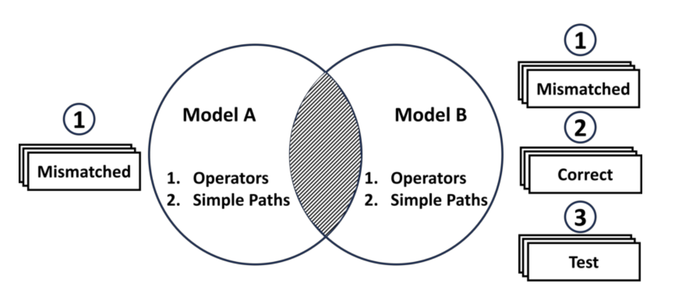
Analysis of Operators and Sequences: Methodology
Finding shared operators and sequences between:
Mismatched
Correct
Test Suite Models

Slide 25
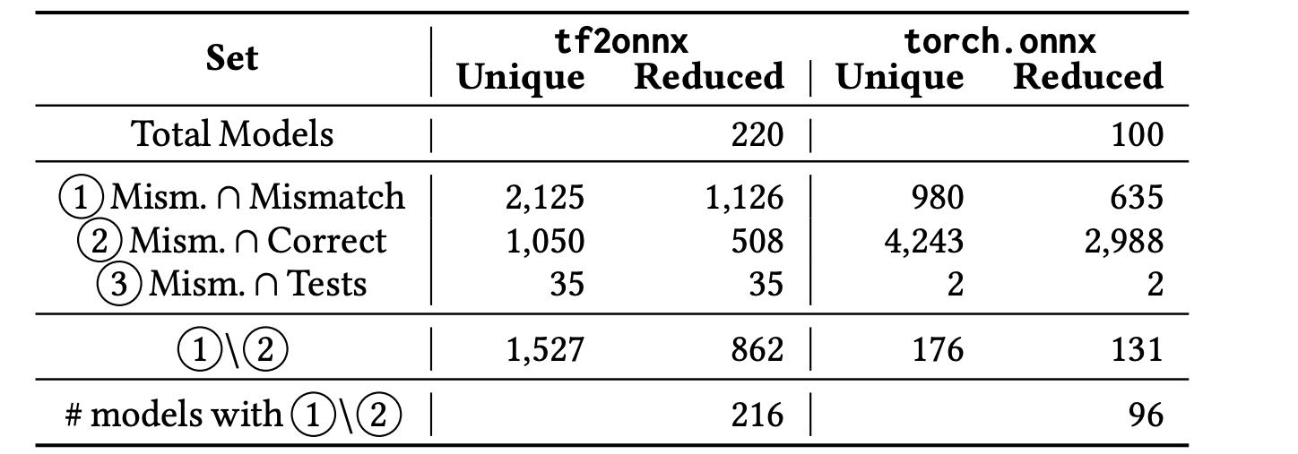
Analysis of Operators and Sequences: Results

Slide 26
Conclusion
Common failure: symptoms crashes and semantically incorrect models.
One stage of converter (node conversion) accounts for ∼75% of the defects.
Deductive causes of erroneous converter behavior elusive
Individual operators are not predictive.
Sequences of operators may be correlated.
Engineers can rely on model converters but should validate the result for behavioural consistency.
Future work: architectural coverage measures for a DL model converter
Future work: refined measure of tolerance after conversion
Notes:
In conclusion:
We study ONNX model converter using a user survey, failure analysis, and hypothesis test
What do we find:
Common failure symptoms are crashes and semantically incorrect models
One stage of conversion accounts for the majority of defects
We are unable to find deductive causes: operators are not predictive, but sequences of operators are.
Engineers should trust but verify, validation of behavioural consistency is important.
Future work:
Coverage measures
Tolerances for validation

Slide 27


Thank you for listening!
arxiv.org/abs/2303.17708
Notes:
The third part of our study focuses upon so-called “deeper cause”.
In summary, we attempt to study converters by attempting to convert different types of models, and by analyzing characteristics of ”failing” models.

Slide 28
Bonus Slides

Slide 29
Failure Analysis:
Notes:
To try to understand how fragile ONNX converters are to changes in the ONNX specification we measure how the number of failures change with each opset release.
On the left you can see the number of operators added/changed in a release. If converters were fragile we would measure failure spikes following a release. On the right you see the cumulative number of failures as measured since the release of ONNX.
We don’t really see any drastic increases.
Quantitatively, we don’t really measure any strong correlations between opset releases and measured failures. We measure a Spearman correlation of 0.34 (a weak positive correlation).
Something that can explain this is the fact that converters typically support multiple opsets, and as such if there is a breaking change typically engineers can convert using an older opset. This is actually one of the solutions users report in our User Study. When they cannot convert they typically attempt to change the opset version.

Slide 30
Model Types and Failures: Methodology
Real Models from the HFTorrent Dataset. (PeatMoss is newer)
Synthetic Models generated using NNSmith.
We test if each model converts and if they exhibit differences in output.
Notes:
We conduct a differential test on two types of models.
What we call real models these are almost exactly as they sound. These models are actual models people use/made. We source them from the HFTorrent dataset, is a collection of repositories from HuggingFace, including models and weights.
So-called synthetic models are models that are created through some model generator (in this case NNSmith which was made for fuzzing DL compilers). These models do not have a structure that is use-able for any task. For example, you could not train an image classifier using them because, frankly the architectures are non-sensical.
For each type of model we first convert it to ONNX and then pass some random inputs into to the model and compare the outputs of the original model with the ONNX model. When the difference is too great we flag that model as “mismatching”. We study these in depth further.

Slide 31
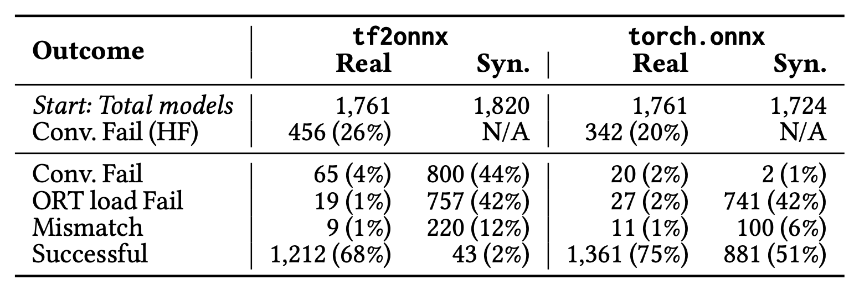
Model Types and Failures: Result
Real models: crashes and incorrect behavior affected only 5% of models.
Synthetic models: incorrect behaviour 320/3544 (9%) vs. 20/1605 real models (1%).
Notes:
Here are our results. First, note that for real models these converters are relatively robust. Incorrect behaviour (mismatches) and crashes only affect 5% of models. This indicates that at least for the “happy path” converters are pretty well designed.
When we

